Slide 1
Acids and Bases
Lucarelli Chapter 17

Slide 2
Pop quiz
Write chemical equations and NIE for the following reactions:
1. nitric acid is added to magnesium metal
2. sulfuric acid is added to sodium carbonate solid
3. phosphoric acid is added to potassium hydroxide solution
4. hydrochloric acid is added to nickel (II) hydrogen carbonate solid
5. ethanoic acid is added to solid sodium sulfite

Slide 3
Common Acids
HCl hydrochloric acid
HNO₃ nitric acid
H₂SO₄ sulfuric acid
H₃PO₄ phosphoric acid
CH₃COOH ethanoic acid

Slide 4
Arrhenius theory of acids and bases
An acid is a substance that will ionise in solution producing H⁺ (aq) ions
HCl (aq) → H⁺ (aq) + Cl⁻ (aq)
A base is a substance that will dissociate in solution releasing OH⁻ ions
NaOH (s) → Na⁺ (aq) + OH⁻ (aq)

Slide 5
Concentration of Acids
What is the difference between 1 mol L⁻¹ HNO₃ and H₂SO₄?
Use the word monoprotic, diprotic etc.
Can you think of a triprotic acid?
What is the difference between a concentrated and dilute acid?

Slide 6
Strong and weak
See Lucarelli Chapter 17 for list of strong and weak acids/bases.

Slide 7
Metal and non-metal oxides
Non-metal oxides are acidic.
CO₂ (g) + H₂O (l) → H₂CO₃ (aq) H₂CO₃ (aq) → H⁺ (aq) + HCO³⁻ (aq)
SO₃ (g) + H₂O (l) → H₂SO₄ (aq) H₂SO₄ (aq) → H⁺ (aq) + HSO₄²⁻ (aq)
Metal oxides are basic.
Na₂O (s) → 2 Na⁺ (aq) + O²⁻ (aq)
O²⁻ (aq) + H₂O (l) → 2 OH⁻ (aq)

Slide 8
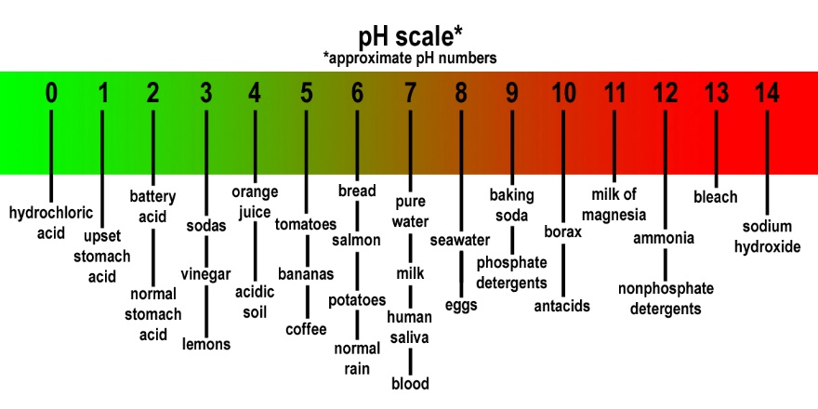
pH

Slide 9
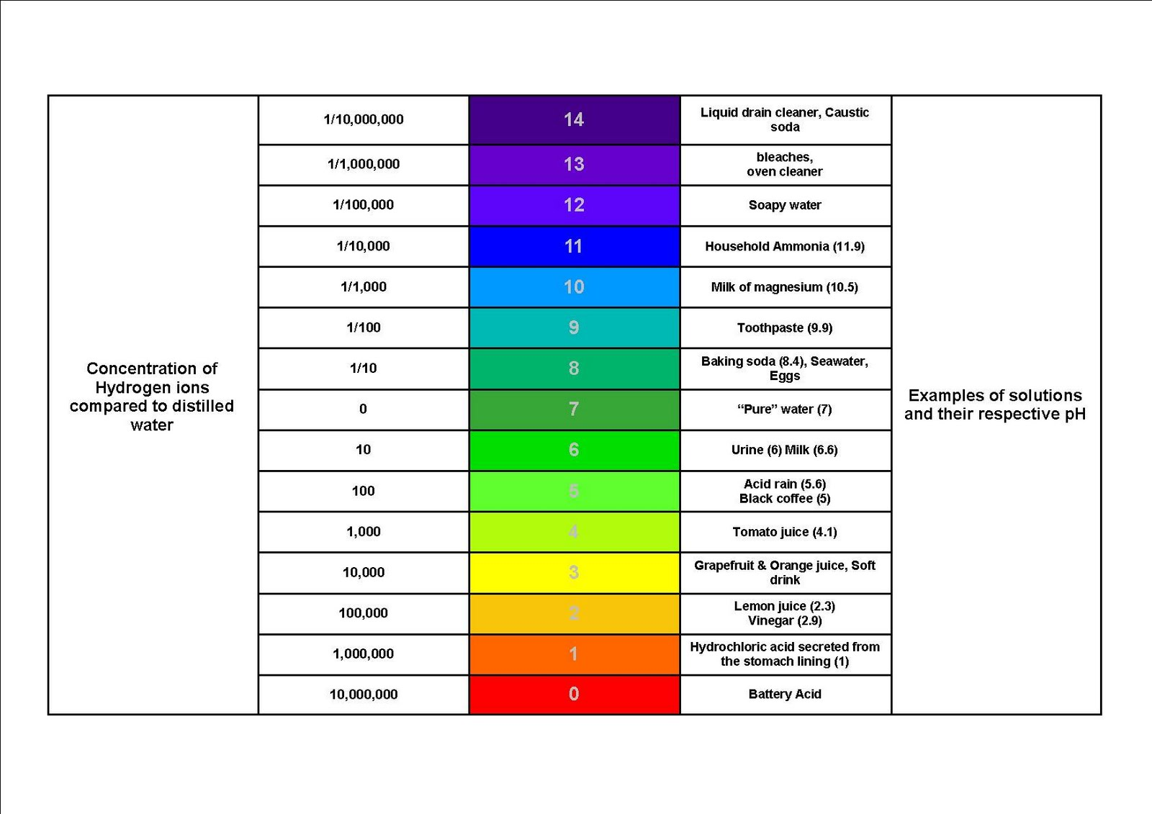

Slide 10
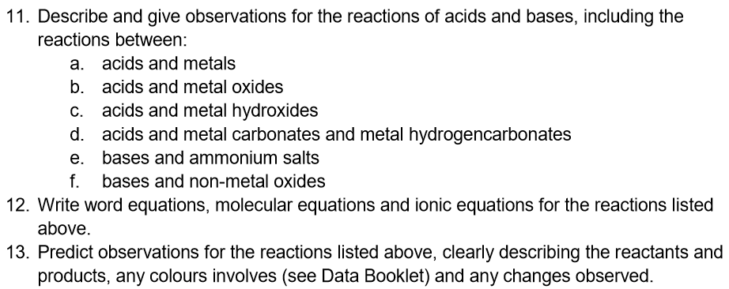
objectives

Slide 11
Acid Base Reactions
See Lucarelli 17.1

Slide 12
Write the formula and net ionic equation for these chemical reactions:
Barium hydroxide solution + sodium carbonate solution
Calcium metal + hydrochloric acid
Potassium hydroxide solution + copper (II) chloride solution

Slide 13
Hydrochloric acid is added to zinc metal
Nitric acid is added to copper (II) oxide solid
Sulphuric acid is added to sodium hydroxide solution
Ethanoic acid is added to sodium carbonate solution
Phosphoric acid is added to barium hydrogen carbonate solid
Nitric acid is added to silver metal
Sodium hydroxide solution is added to ammonium sulfate solution
Carbon dioxide gas is bubbled through a potassium hydroxide solution
Sulfur trioxide gas is bubbled through a sodium hydroxide solution
Ethanoic acid is added to magnesium metal

Slide 14
2 HCl (aq) + Zn (s) -> ZnCl₂ (aq) + H₂ (g)
2 H⁺ (aq) + Zn (s) -> Zn²⁺ (aq) + H₂ (g)
A colourless solution is added to a grey solid. The solid is consumed and a colourless odourless gas is evolved
2 HNO₃ (aq) + CuO (s) -> Cu(NO₃)₂ (aq) + H₂O
2 H⁺ (aq) + CuO (s) -> Cu²⁺ (aq) + H₂O
A colourless solution is added to a black solid. The solid is consumed to produce a blue solution.

Slide 15
H₂SO₄ (aq) + NaOH (aq) -> Na₂SO₄ (aq) + H₂O (l)
H+ (aq) + OH- (aq) -> H₂O (l)
No visible reaction.
CH₃COOH (aq) + Na₂CO₃ (aq) - > 2 NaCH₃COO (aq) + CO₂ (g) + H₂O (l)
CH₃COOH (aq) + CO₃²⁻ (aq) - > 2 CH₃COO⁻ (aq) + CO₂ (g) + H₂O (l)
A colourless solution is added to a white solid. The solid is consumed and a colourless odourless gas is evolved.

Slide 16
2 H₃PO₄ (aq) + 3 Ba(HCO₃)₂ (s) -> Ba₃(PO₄)₂ (s) + 6 CO₂ (g) + 6 H₂O (l)
A colourless solution is added to a white solid. The solid is consumed and a new white solid id formed. A colourless odourless gas is evolved in a colourless solution.

Slide 17
HNO₃ (aq) + Ag (s) -> no reaction
No visible reaction
NaOH (aq) + NH₄SO₄ (aq) -> Na₂SO₄ (aq) + NH₃ (g) + H₂O (l)
OH⁻ (aq) + NH₄⁺ (aq) -> NH₃ (g) + H₂O (l)
Two colourless solutions are mixed. Bubbles are produced evolving a colourless odourless gas.

Slide 18
CO₂ (g) + 2 KOH (aq) -> K₂CO₃ (aq) + H₂O (l)
CO₂ (g) + 2 OH⁻ (aq) -> CO₃²⁻ (aq) + H₂O (l)
A colourless odourless gas is bubbled through a colourless solution to produce a colourless solution.
CH₃COOH (aq) + Mg (s) -> Mg(CH₃COO)₂ (aq) + H₂ (g)
CH₃COOH (aq) + Mg (s) -> Mg²⁺ (aq) + 2 CH₃COO⁻ (aq) + H₂ (g)
A colourless solution is added to a grey coloured solid. The solid is consumed and a colourless odourless gas is produced.

Slide 19
Practice
Lucarelli Ch17 Sets 29 and 30
STAWA Set 27

Slide 20
Ph Summary
Kw = [H⁺] [OH⁻] = 1 x 10⁻¹⁴
pH = -log [H⁺] pOH = -log [OH⁻]
pH + pOH = 14
[H⁺] = 10^{-pH} [OH⁻] = 10^{-pOH}

Slide 21
Question
Determine the H⁺ and OH⁻ concentrations of a sample of swimming pool water with a pH of 6.2.
Answer: 1.58 x 10⁻⁸ mol L⁻¹

